Slide 1
Crime Analysis and Prediction using Optimized KNN Algorithm
GUIDED BY
AISHWARYA T M (211418104009) Mrs.R.DEVI,M.E.,
ASHMIN ANGEL A (211418104028) ASSISTANT PROFESSOR
SRINIDHI ISWARYA B.K (211418104263) DEPARTMENT OF CSE
PANIMALAR ENGINEERING COLLEGE
CHENNAI

Slide 2
INTRODUCTION:
The objective of this project is to tackle a vital issue in the society - Crimes. Analyzing and examining of crimes happening in the world will give us a Broadview in understanding the crime regions and can be used to take necessary precautions to mitigate the crime rates.
Identifying Crime patterns will allow us to tackle problems with unique approaches in specific crime category regions and improve more security measures in society. Current studies show the reason of increase in crime rates is more in areas that are economically backward. In few decades’ property crime will be a target.
The following approach involves predicting crimes classifying, pattern detection and visualization with effective tools and technologies. Use of past crime data trends helps us to correlate factors which might help understanding the future scope of crimes.

Slide 3
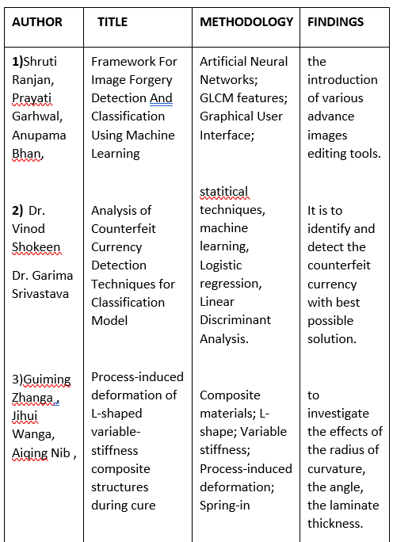
LITERATURE SURVEY:

Slide 4
PROBLEM STATEMENT: EXISTING SYSTEM
In this system they are proposed logistic regression and K-means classifiers. Researches have been done to study the relation between criminal activities and socio-economic variables like unemployment income level race level of education.
PROPOSED SYSTEM
Property crime more than doubled over the same period. Since the 1990s, however, crime in the United States has declined steadily. Until recently crime prevention was studied based on strict behavioural and social methods, but the recent developments in Data Analysis have allowed a more quantitative approach in the subject. We will explore a dataset of nearly 12 years of crime reports from across all of San Francisco's neighbourhoods, and we will create a model that predicts the category of crime that occurred, given the time and location.

Slide 5
DEVELOPMENT ENVIRONMENT:
SOFTWARE ENVIRONMENT:
Operating System : Windows 7 , 8, 10 (64 bit)
Software : Python and Anaconda Navigator
HARDWARE ENVIRONMENT:
Hard Disk : 500GB and Above
RAM : 4GB and Above
Processor : I3 and Above

Slide 6

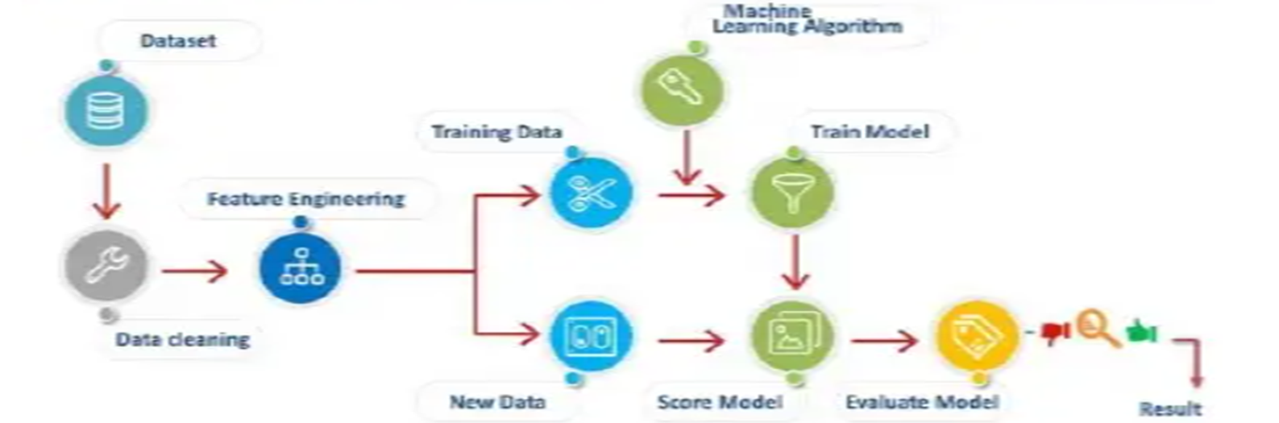






SYSTEM ARCHITECTURE:

Slide 7
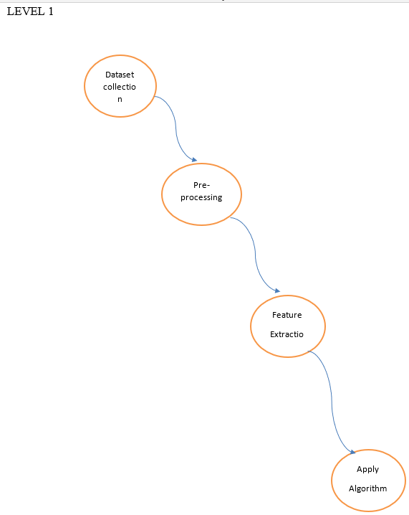
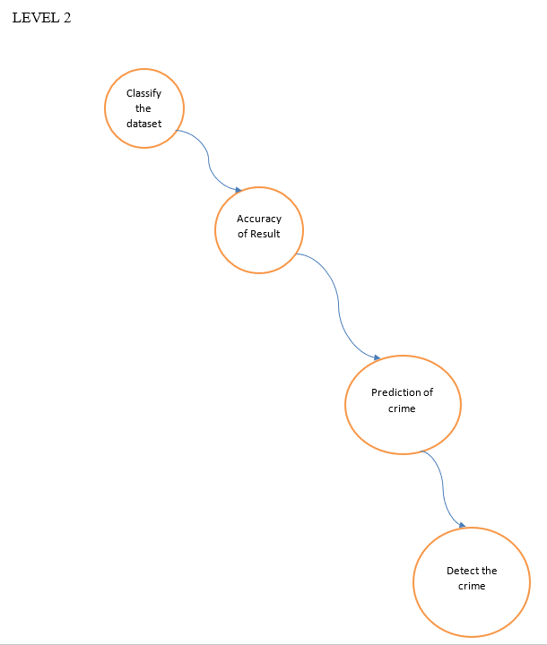
Data flow diagram

Slide 8
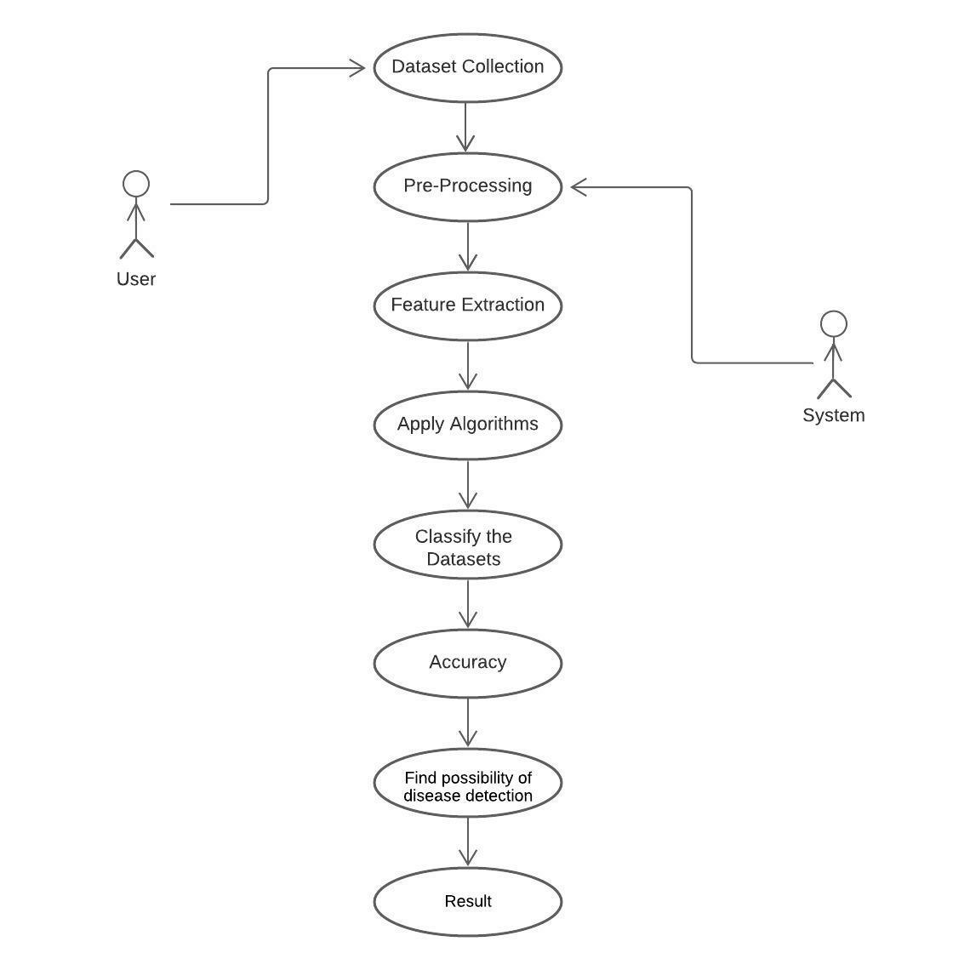
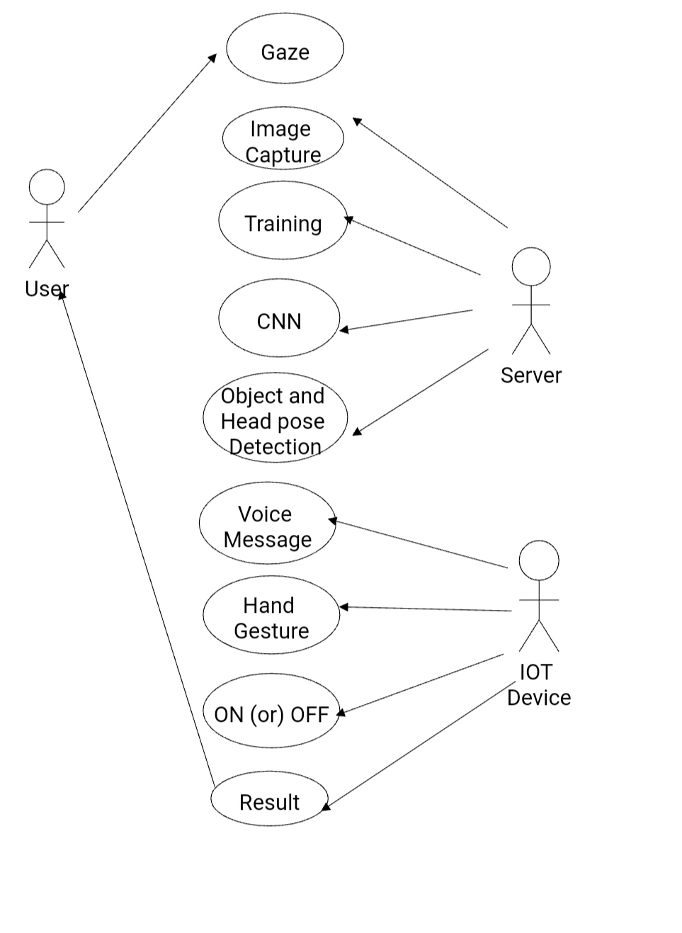
USE CASE DIAGRAM:

Slide 9
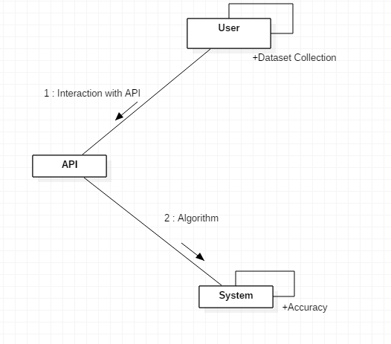
COLLABORATION DIAGRAM:

Slide 10
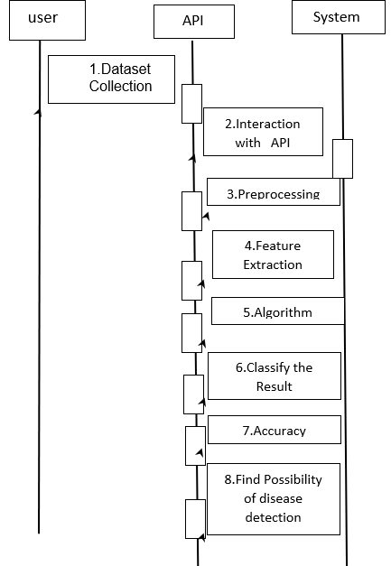
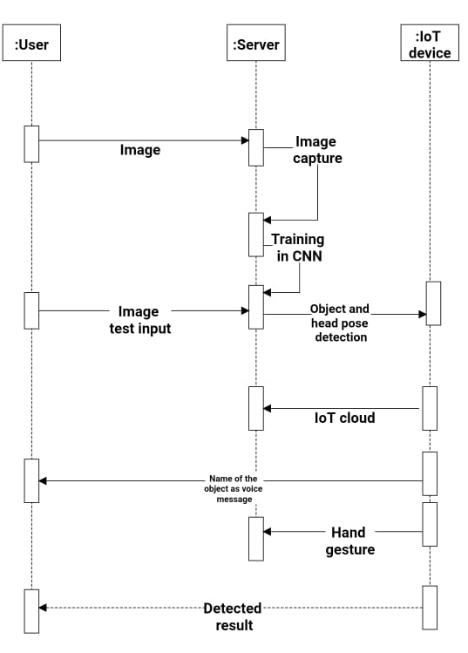
SEQUENCE DIAGRAM:

Slide 11
MODULE DESCRIPTION:
There are four modules in our project .The list of modules are as follows:
DATA COLLECTION
DATA PRE-PROCESSING
FEATURE EXTRATION
EVALUATION MODEL

Slide 12
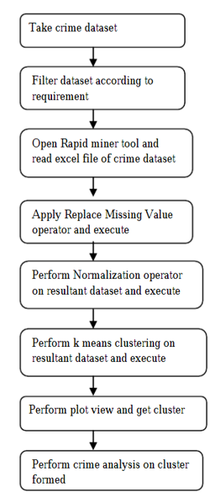
MODULE FLOW

Slide 13
FLOW EXPLANATION
First, we take wrongdoing dataset, Channel dataset as indicated by prerequisite and make new dataset which has ascribe as per investigation to be done.
Open quick digger device and read exceed expectations record of wrongdoing dataset and apply "Supplant Missing worth administrator" on it and execute activity. Perform "Standardize administrator" on resultant dataset and execute activity.
Perform k implies grouping on resultant dataset framed after standardization and execute activity.
From plot perspective on result plot information among wrongdoings and get required group. Examination should be possible on bunch framed.

Slide 14
MODULE 1: DATA COLLECTION MODULE:
Data collection is the process of gathering and measuring information from countless different sources. In order to use the data we collect to develop practical artificial intelligence (AI) and machine learning solutions, it must be collected and stored in a way that makes sense for the business problem at hand. Data for which you already know the target answer is called labelled data.

Slide 15
MODULE 2 : DATA PRE-PROCESSING
Organize our selected data by formatting, cleaning and sampling from it.
Three common data pre-processing steps are:
Formatting: The data we have selected may not be in a format that is suitable for you to work with.
Cleaning: Cleaning data is the removal or fixing of missing data. There may be data instances that are incomplete and do not carry the data you believe you need to address the problem. These instances may need to be removed
Sampling: There may be far more selected data available than you need to work with. More data can result in much longer running times for algorithms and larger computational and memory requirements.

Slide 16
MODULE 3: Feature Extraction
Feature Extraction:
Features selection is done which can be used to build the model.
The attributes used for feature selection are Block, Location, District, Community area, like dates, crime description, day of week, X, Y, Location.

Slide 17
MODEL 4: EVALUATION MODEL
In this module we implement the algorithm which one give best accuracy value.
Based on that applying the algorithm it should calculate and give the accuracy. Here we are applying the algorithm and get the result on the form of graphical format.

Slide 18
TESTING METHODS
Functional Testing
Functional tests provide systematic demonstrations that functions tested are available as specified by the business and technical requirements, system documentation, and user manuals.
Functional testing is centered on the following items:
Functions: Identified functions must be exercised. Output: Identified classes of software outputs must be exercised. Systems/Procedures: system should work properly
Integration Testing
Software integration testing is the incremental integration testing of two or more integrated software components on a single platform to produce failures caused by interface defects.

Slide 19
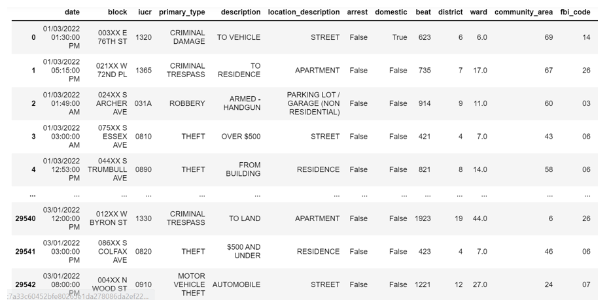
SCREENSHOT

Slide 20
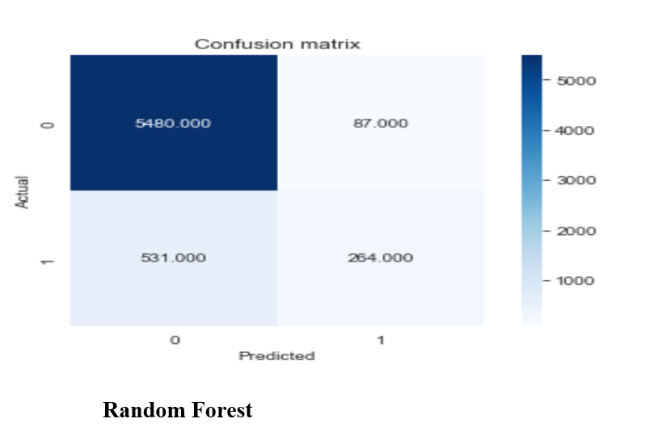
SCREENSHOT

Slide 21
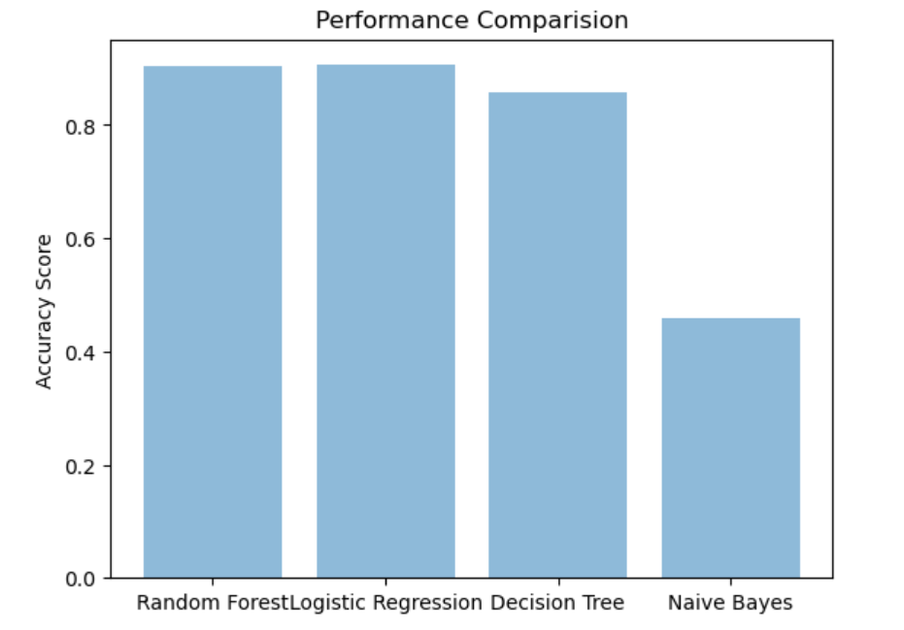
SCREENSHOT

Slide 22
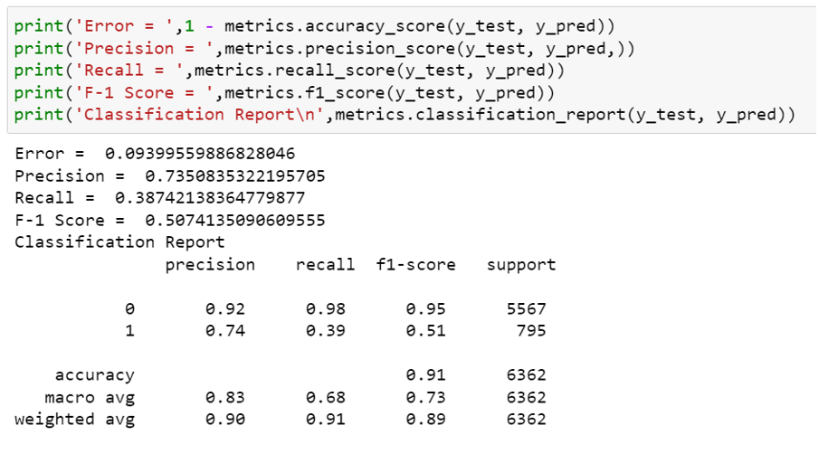
SCREENSHOT

Slide 23
CONCLUSION:
In the present study, ML models with machine learning algorithms (ensemble and simile), SVm, SVM-Random forest, SVM-stacking and Naive Bias, were designed and were implemented.
Each predetermined factor was feed into a violent crime training dataset (murder, rape, robbery, etc.). We discovered a major conclusion after successfully training and validating simodels.

Slide 24
REFERENCES:
[1] M. Cahill and G. Mulligan, ‘‘Using geographically weighted regression to explore local crime patterns,’’ Social Sci. Comput. Rev., vol. 25, no. 2, pp. 174–193, May 2007, doi: 10.1177/0894439307298925.
[2] J. M. Caplan, L. W. Kennedy, and J. Miller, ‘‘Risk terrain modeling: Brokering criminological theory and GIS methods for crime forecasting,’’ Justice Quart., vol. 28, no. 2, pp. 360–381, Apr. 2011, doi: 10.1080/07418825.2010.486037.
[3] A. Almehmadi, Z. Joudaki, and R. Jalali, ‘‘Language usage on Twitter predicts crime rates,’’ in Proc. 10th Int. Conf. Secur. Inf. Netw., Oct. 2017, pp. 307–310, doi: 10.1145/3136825.3136854.
[4] V. K. Borooah and N. Ireland, ‘‘Deprivation, violence, and conflict: An analysis of Naxalite activity in the districts of India,’’ Int. J. Conf. Violence, vol. 2, no. 2, pp. 317–333, 2008, doi: 10.4119/UNIBI/ijcv.42.
[5] A. Babakura, M. N. Sulaiman, and M. A. Yusuf, ‘‘Improved method of classification algorithms for crime prediction,’’ in Proc. Int. Symp. Biometrics Secur. Technol. (ISBAST), Aug. 2014, pp. 250–255, doi: 10.1109/ISBAST.2014.7013130.

